Slide 1
Lecture 12
Programme to ensure self-regulation and Health

Slide 2


Slide 3
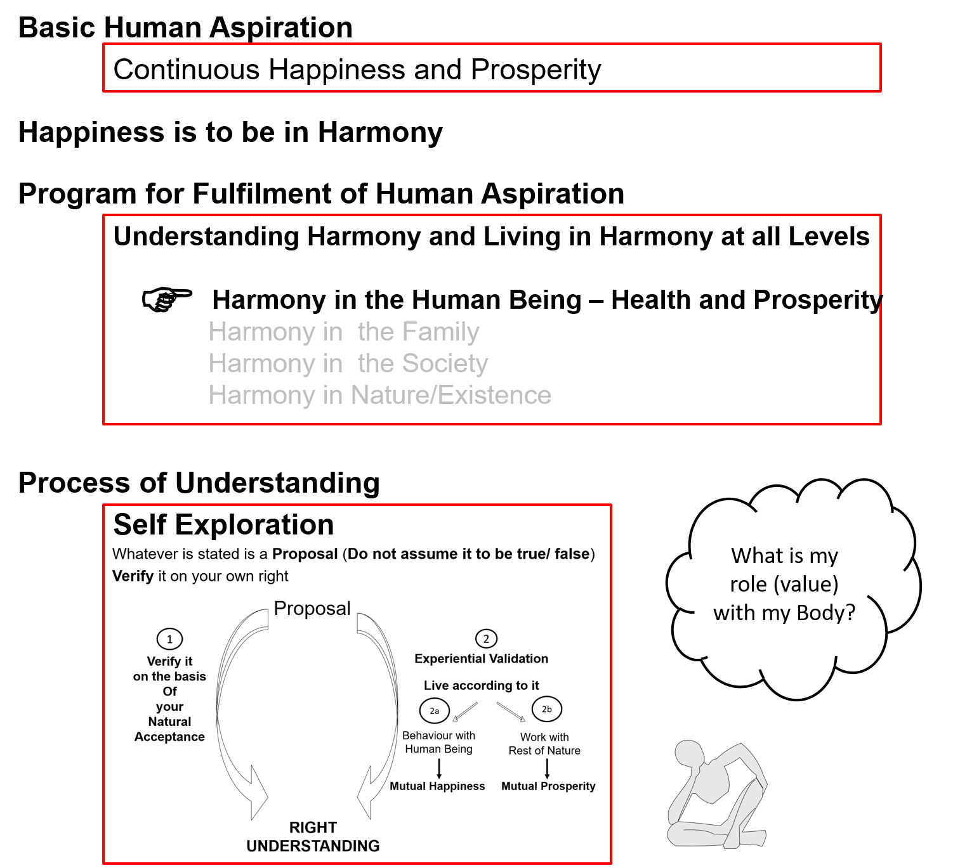

Slide 4
Human Being Ekkuo | Self eSa | Body “kjhj
Need vko';drk | Happiness (e.g. Respect) lq[k ¼tSls lEeku½ | Physical Facility (e.g. Food) lqfo/kk ¼tSls Hkkstu½
In Time dky esa | Continuous fujUrj | Temporary lkef;d
In Quantity ek=k esa | Qualitative (is Feeling) xq.kkRed ¼Hkko gS½ | Quantitative (Required in Limited Quantity) Ekk=kRed ¼lhfer ek=k esa½
Fulfilled By iwfrZ ds fy, | Right Understanding & Right Feeling lgh le>] lgh Hkko | Physio-chemical Things HkkSfrd&jklk;fud oLrq
Activity fØ;k | Desire, Thought, Expectation… bPNk] fopkj] vk”kk--- | Eating, Walking… [kkuk] pyuk---
In Time dky esa | Continuous fujUrj | Temporary lkef;d
Response | Knowing, Assuming, Recognising, Fulfilling tkuuk] ekuuk] igpkuuk] fuokZg djuk | Recognising, Fulfilling igpkuuk] fuokZg djuk
 | Consciousness pSrU; | Material tM+
Co-existence
lgvfLrRo

Slide 5
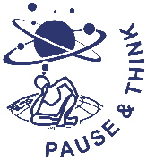
Human Being Ekkuo | Self (I) eSa | Body “kjhj
Need vko';drk | Happiness (e.g. Respect) lq[k ¼tSls lEeku½ | Physical Facility (e.g. Food) lqfo/kk ¼tSls Hkkstu½
Fulfilled By iwfrZ ds fy, | Right Understanding & Right Feeling lgh le>] lgh Hkko | Physio-chemical Things HkkSfrd&jklk;fud oLrq
 | Feeling of Self-regulation (संयम) | Health
 | Feeling of responsibility toward the body – for Nurturing, Protection and Right Utilization of the Body | The Body acts according to the Self Parts of the body are in harmony (in order)
Co-existence
lgvfLrRo
Notes:
Who is the observer? Self or body?
Can you see that you are always active “imagination” is always going on

Slide 6
Feeling of Self-regulation → Program for it → Health in the Body
The Body is an orderly system (a harmony). It has definite conduct.
The cells in the body work together, in harmony with each other, participate in the larger order to form tissues, organs and organ systems…
I (Self) have to ensure the continuity of that harmony (at least not disturb it).
If I have a feeling of responsibility toward the body, I do what is required for fulfilling that responsibility.
This will ensure health in the Body

Slide 7
Program
(A) For Staying Healthy
  1 Intake and Routine (Lifestyle)
  2 Labour and Exercise
  3 Postures for regulating internal & external body organs and
  Regulated Breathing
  4 Medicine and Treatment
(B) For bringing body back to harmony from temporary disharmony
(C) Dependence on drug / machine to perform a body function
1a. Intake includes air, water, sunlight, food (food is nutritious, digestible & tasty and waste is excretable), all intake through our senses (sound, sight, smell etc)
1b. Rising time, sleeping time, eating time…
2a. Outcome of labour is production of physical facility
2b. No physical facility is produced by exercise

Slide 8
Intake
Intake includes not just food but also water, air, sunlight… in fact, all that we take in through our sense organs – i.e. everything we hear, smell, touch, taste or see
  Intake of food – In order to lead to health in the body, food should be
  Nurturing for the Body (awareness in Self of food choices we make)
  Digestible by the Body (awareness in Self of how much to eat – sensation of fullness)
  Tasty
  Compatible with Body type, etc. and
  Waste is excretable by the body (rich in fibre)
  Intake of water - right amount and at the right time
  Intake of fresh air
  Intake of (morning) sunlight
  For keeping the body healthy, we also need to be aware of all intake through our sense organs and the feelings and thoughts we generate in us as a result (especially while eating).
  e.g. what we are seeing (watching TV/ playing games on the mobile while eating, etc.) and
  what we are hearing/being a part of (e.g. arguments with others), etc.

Slide 9
Routine
The Daily Circadian Rhythm
Body responds to the day-night cycle
(sunlight/darkness with earth’s rotation on its axis)
(Understanding this helps in setting up a harmonious daily routine)
The Monthly Lunar Rhythm
- Body responds to the lunar cycle
e.g. menstrual cycle in women
The Annual Seasonal Rhythm
Body response to the various seasons in a year – the solar cycle (earth’s revolutions around sun)
Availability of complementary plants in various seasons
(Understanding this helps in deciding appropriate seasonal intake, necessary protection of the Body and setting up a harmonious seasonal routine)
The Lifecycle Body Rhythm
Childhood – Period of growth/formation (Predominance of Kapha)
Youth - Period of maintenance (Predominance of Pitta)
Old age - Period of degeneration (Predominance of Vata)
(Understanding this helps in deciding a harmonious lifestyle for each stage of life)

Slide 10
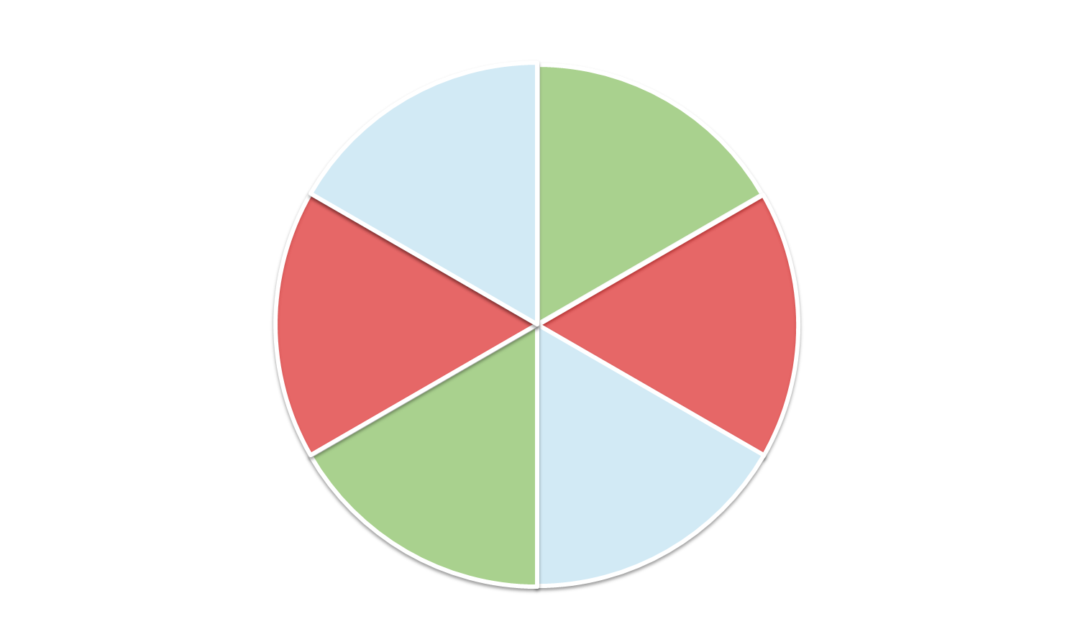
Daily Routine – in Harmony with Nature (Circadian Rhythm)
Cleansing time
6 AM
Wake-up time
(~1½ hrs before sunrise)
Breakfast time
Waste Removal
(Detoxification through Kidneys…)
Air–Space (Vata) time
Earth–Water (Kapha) time
2 AM
10 AM
Regeneration and Repair
(Liver Activation…)
Lunch time
Fire–Water (Pitta) time
Fire–Water (Pitta) time
12 Midnight
12 Noon
Deep Sleep
Maximum Agni (Digestive Fire)
Earth–Water (Kapha) time
Air–Space (Vata) time
10 PM
2 PM
Bed time
Absorption and
Assimilation
Dinner time
6 PM

Slide 11
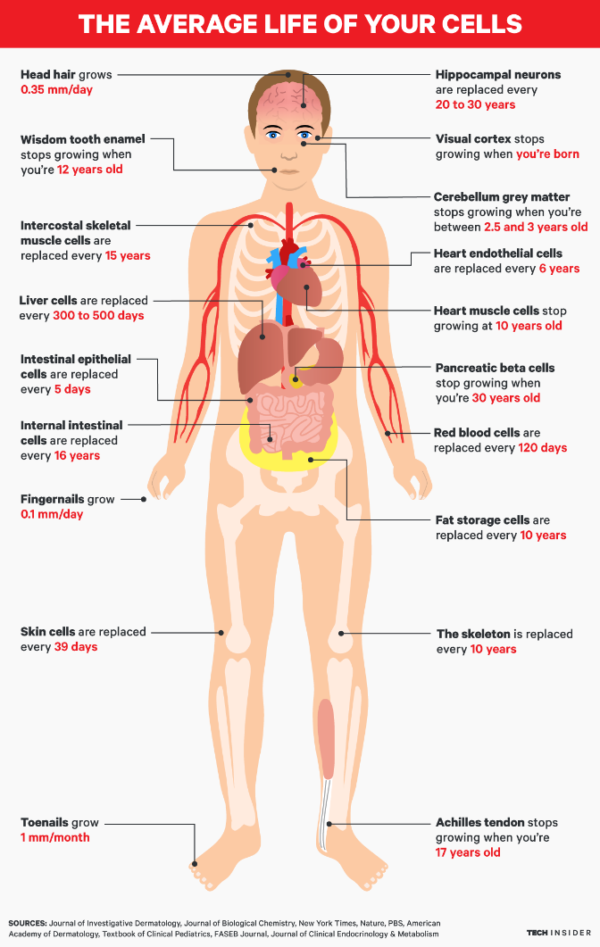

Slide 12
Understanding the Body
(day 1 doc)
The Body – from a single cell to a huge harmony of trillions of cells working together…
  Homeostatis
  Principle of regeneration of Body tissues
  Basic life processes
  Organ systems
A healthy Body is naturally a harmony in itself and is in harmony with the natural environment
It is the Self that has to decide how to stay in harmony or otherwise by way of the lifestyle (intake, routine etc.)

Slide 13
Basic Principles Governing Health of Body
(day 3 doc)
Principle of accumulation
The body is an accumulation of intake
(Understanding this helps in deciding intake)

Slide 14
Basic Principles Governing Health (cont.)
Principle of similarity and dissimilarity
Body type
(Understanding this helps in deciding intake, routine etc. for your body type)
Principle of availability of information from Body
The Self only has to be aware, read it and act
(Understanding this helps in reading and responding to signals from the Body)
Principles related to influence of the state of Self on health of Body(Understanding this will influence the way you look at health:
Holistic Human Health = health of Self + health of Body + health of the environment
Environment = family, society, nature/existence)

Slide 15
Indicators of Health of Body
(day 3 p 2)
Add flexibility of the Body

Slide 16
Labour Exercise
Ensure adequate movement of the Body + production of physical facility
Examples:
  Sweeping and swabbing your room / house / hostel
  Kitchen gardening
  Cycling to your college and back…
Ensure adequate movement of the Body
Examples:
  Jogging outdoors
  Weight training in a gym
  Exercise cycling in a gym
  Recreational cycling outdoors

Slide 17
Postures Breathing
Postures for regulating internal and external body organs
Example: Yoga
Regulated Breathing
Example: Pranayam

Slide 18
Medicine
Treatment
For bringing body back to harmony from temporary disharmony
Examples:
  Home remedies
  Integrated systems of medicine
Using a drug / machine to perform a body function (dependence)
Examples:
  Insulin
  Dialysis
  Ventilator

Slide 19
Program – Priority
(A) For Staying Healthy
1a
  1 Intake and Routine (Lifestyle)
  2 Labour and Exercise
  3 Postures for regulating internal & external body organs and
  Regulated Breathing
  4 Medicine and Treatment
1
1b
2
(B) For bringing body back to harmony from temporary disharmony
3
(C) Dependence on drug / machine to perform a body function
1a. Intake includes air, water, sunlight, food (food is nutritious, digestible & tasty and waste is excretable), all intake through our senses (sound, sight, smell etc)
1b. Rising time, sleeping time, eating time…
2a. Outcome of labour is production of physical facility
2b. No physical facility is produced by exercise

Slide 20
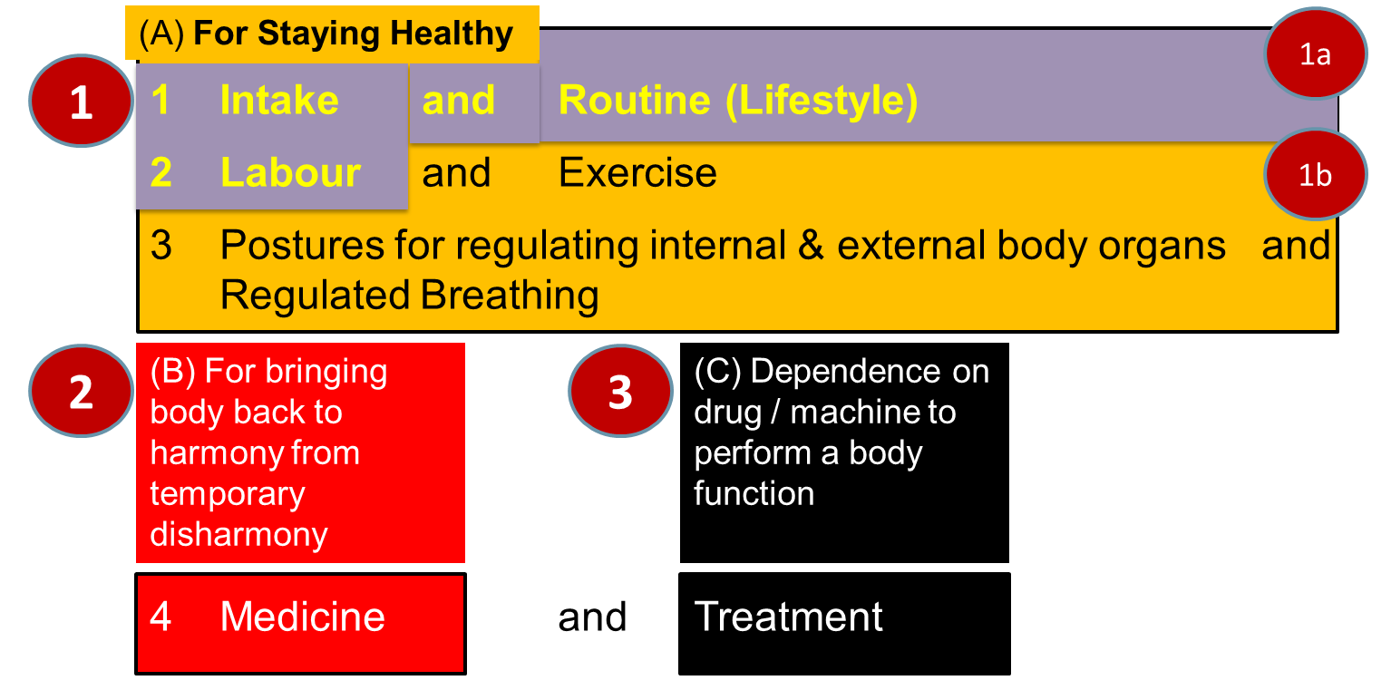
Sum Up
The Self and the Body are in Harmony when there is a feeling of Self-regulation in the Self and Health in the Body
  Self-regulation = Feeling of responsibility toward the body – for Nurturing, Protection and Right Utilization of the Body
  Health = The body acts according to Self and parts of the body are in harmony (in order)
Program

Slide 21
Practice Session after Lecture 12
In the last 3 years, recall the times that your body has been ill (in disharmony). What steps were taken to restore the harmony of the Body?
If you were to take full responsibility for your body (i.e. you had the feeling of self-regulation), what kind of daily schedule would you have? Approximately how much time would you allocate for keeping your body in good health through:
  Healthy intake (food, air, water, sunlight, etc.)
  Timings for upkeep of the Body (sleeping and waking up time, excretion, bathing, etc.)
  Labour (production of physical facility)
  Exercise
  Balancing internal and external organs of body
  Regulating breathing of body
  Medicine
  Treatment
(Of course, you need to keep adequate time for studying, understanding, learning, behaviour, work etc.)
Do you think this schedule will make you more productive or less productive? What conclusions do you draw from this exercise?
Date(s) | Illness or disharmony | Type (Accident, viral infection, bacterial infection, lifestyle related disorder, any other) | Steps taken | Root Cause

Slide 22
Practice Session after Lecture 12…
2. Calculate the quantity required for a specific physical facility, say clothes, in your family. Now find out the quantity available. Is the quantity available less, equal or more than the quantity required? In that sense, do you feel prosperous or deprived (at least regarding that particular physical facility)? Do the same for other needs. For that you can make an inventory of everything in your home (or at least your room). How much of the physical facility is being rightly utilised? Discuss this with your family and work out your conclusions regarding:
  Meaning of prosperity
  The role of understanding (human being, the role of physical facility and the feeling of self-regulation)
  Ability of your family to identify its needs, with the required quantity

Slide 23
Expected Outcome
The students are able to list down activities related to proper upkeep of the Body and practice them in their daily routine. They are also able to appreciate the plants growing in and around the campus which can be beneficial in maintaining their health and even curing common ailments.
The students begin to recognise that the need for physical facility for nurturing, protection and right utilization of their body is limited in quantity. In cases where they are able to see that they have more than enough physical facility, they develop a feeling of prosperity. In cases of lack in physical facility, they start thinking about how to produce more than required physical facility by way of a mutually-enriching cyclic process (rather than through exploitation).

Slide 24
Exercise 2
Observing (seeing)
the Body
and
the interaction between the Self and the Body
– by the Self
Note:
This is just one way of looking within (not the only way)
The steps mentioned in this exercise are one possible set of steps
(not the only set of steps)

Slide 25
Step 1: Observing the Self and the Body – by the Self
I am
On the basis of observing (seeing) my activities
The Self is a reality (it exists, it is an existential reality)
The Body is
On the basis of observing (seeing) or reading sensation from the Body
The Body is a reality (it exists, it is an existential reality)
The Self and the Body are two distinct realities
I am able to observe this

Slide 26
Step 2: Observing the interaction between the Self and the Body
– by the Self
What is the interaction between me and the body?
I give instructions to the body
I give only those instructions to the body that I consider to be important. As and when I want to take some work from the body, I give it some instructions (like ‘get up’, ‘walk’, ‘sit down’…)
Instruction is an information
On the basis of events taking place in the body, sensations are taking place
I read those sensations that I consider to be important. I taste the sensations that I read
Sensation is also an information
The interaction between the Self and the Body is only in the form of information (not of any physio-chemical things)

Slide 27
Step 3: Observing the Decisionmaker
Who is deciding to give instructions to the Body or to read specific sensations from the Body?
Is it the Self or the Body?
I am the one who decides to give instructions to the body
I am the one who decides to read specific sensations from the body, sensations which I consider important
The decisions regarding the exchange of information between me and the body are entirely mine
I interact with the body as and when I require
I interact with the body from time to time (not continuously)
The Body acts according to the instruction that I give it
I use the body as per my decision, I use the body as an instrument

Slide 28
FAQs for Lecture 12
Programme to ensure self-regulation and Health

Slide 29
Questions
Is self-regulation same as self control or self restraint?
What will be the role of a doctor if everyone has the feeling of self-regulation?
If body is unhealthy, will the Self be still happy?
...

Slide 30
Day 2 Session 1-4
Human being is co-existence of Self, a conscious entity, and Body, a material entity.
The Self and the Body can be distinguished on the basis of their needs, activities and response
The Self is the seer, doer and enjoyer (experiencer), body is an instrument. In that sense, the Self is central to human existence
The Self consists of the activities of imaging, comparing, analysing, tasting, selecting… together referred to as imagination (also Block B2)
Behaviour and work are expressions of imagination (first it happens in the imagination)
There are three possible sources of motivation for imagination – preconditioning, sensation and natural acceptance
The Self is self-organized (स्वतंत्र) when imagination is guided by right understanding (Block B1)
The Self is enslaved when imagination is motivated by preconditioning or sensation
The feeling of self-regulation in the Self is essential to ensure health in the Body and for having the clarity about the need for physical facility and prosperity.
There is a definite program for self-regulation.
For clarity about the Self and Body, two exercises are proposed:
  observing the Self by the Self and
  observing the interaction of the Self with the body by the Self.

Slide 31

Quiz

Slide 32
Self Reflection

Slide 33
Question(s): Response
Is self-regulation same as self control or self restraint?
  Self-regulation is defined as- Feeling of responsibility toward the body – for Nurturing, Protection and Right Utilization of the Body.
  With this feeling of responsibility, the self takes care of the body.
  When we talk about self control or self restraint, the sense we get is that the self is controlling things related to body with a feeling of fear or of opposition.
  For example, with feeling of responsibility, I eat food which is nutritious and tasty, but, I don’t eat food which is tasty but, not nutritious. This happens in a natural manner. On the other hand, if I don’t have this feeling of responsibility, and I want to eat food which is tasty but not nutritious, however, due to fear of falling sick, I am not eating that food, then, this is self restraining. This doesn’t happens in a natural manner and somewhere I have a feeling of unhappiness.

Slide 34
Question(s): Response
The body has an ageing process and with age diseases start appearing. Also there are viruses etc. Will a person with right understanding and feeling of self-regulation not have such diseases?
Is health of body also a human value?
  In general, a person with right understanding and feeling of self-regulation will be able to maintain the health of his body and not fall sick. However, the aging of the body will certainly have its effect, but, he will be able to see this and plan his lifestyle accordingly. Similarly, tmhe effect of environment such as extreme weather or even viruses can effect the health of his body. But,, he will handle this by taking preventive measures or by doing the necessary detoxification or taking the suitable medicine, so that the body can recover its health.
  Feeling of Self-regulation is value in the self, which expresses itself as health in the body. This can be seen as the feeling of care towards the body.

Slide 35
Question(s): Response
What would be right utilisation of a healthy Body?
The Self is central to human existence
The purpose Self is to develop completeness of
  Right understanding, i.e. understanding of harmony at all levels of being – Truth
  Right feeling, i.e. feeling of harmony – Love
  Right thought, i.e. thought of how to live in harmony – Compassion
The Body is used as an instrument by the Self for interacting with the world outside:
  Behaviour with human being
  Work with rest of nature
Physical facility is required for the Body – to nurture it, protect it and in the process of right utilisation of the Body

Slide 36
Question(s): Response
If body is unhealthy, will the Self be still happy?
How do you distinguish between mental health and physical health?
As we have discussed, happiness in the self can be unsured through right understanding and right feelings which has to do with the state of the self and not state of the body. However, if the body is unhealthy, it will be a matter of concern, and the person with right understanding will do whatever is necessary for recovering the health of the body, without getting unhappy over it.
Mental health has to with disharmony at the level of self, but, Physical health has to with disharmony at the level of Physical body.

Slide 37
Question(s): Response
Why is medicine and treatment kept separate – aren’t they similar?
As discussed in the session,
medicine is used-r bringing body back to ary For bringing body back to harmony from temporary disharmony
this can be done through Home remedies or through Integrated systems of medicine
However, Treatment has to do with
Using a drug / machine to perform a body function (dependence)
For examples, by using Insulin in case of diabetes or doing Dialysis for blood purification.

Slide 38
Question(s): Response
What will be the role of a doctor if everyone has the feeling of self-regulation?
The major role of the doctors then would be
Health education- education that will enable people to have this feeling of self-regulation and develop the competence to take care of the health of their body
To help them to take preventive measures for the effect of the environment
Provide them necessary help to recover if their body falls sick due to the effect of the environment through
      detoxification or
      medicine
Provide treatment, only in extreme cases when there is no option to take any other recourse

Slide 39
Question(s): Response
Like this doctors will become unemployed… What about their income? Today health-care is a thriving multi billion dollar industry employing millions of people! What will happen to all that?
Check what is naturally acceptable:
A system that ensures health
A system based on illness
So, we have to make effort for that kind of system. Ultimately, a system for the wellbeing of all (what NEP2020 calls and equitable and just society). People with a holistic world-view, competence and commitment may be able to work towards such a society. We will discuss this when we cover harmony in society

Slide 40
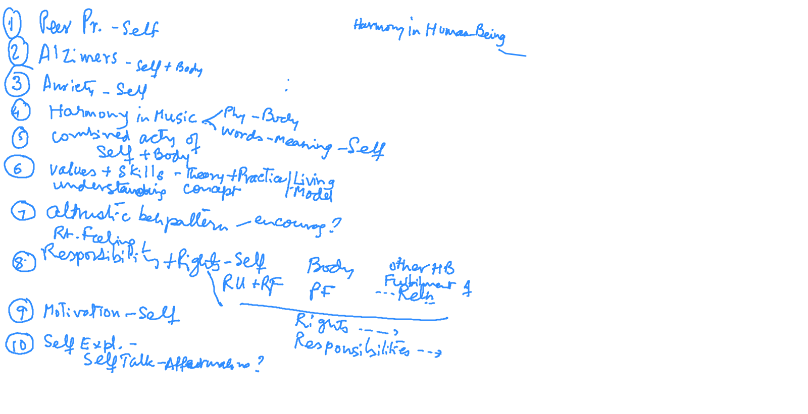
Q&A at end of Module 1 & 2 [22-01-2021]

